Slide 1
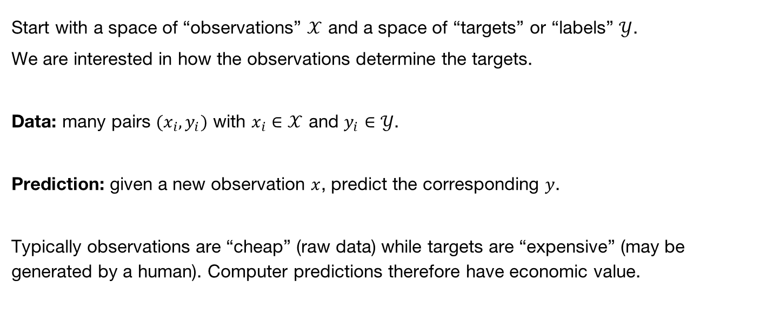
Machine Learning Background I
Start with a space of “observations” $𝒳$ and a space of “targets” or “labels” $𝒴$.
We are interested in how the observations determine the targets.
Data: many pairs $(x_{i},y_{i})$ with $x_{i}∈𝒳$ and $y_{i}∈𝒴$.
Prediction: given a new observation $x$, predict the corresponding $y$.
Typically observations are “cheap” (raw data) while targets are “expensive” (may be generated by a human). Computer predictions therefore have economic value.

Slide 2
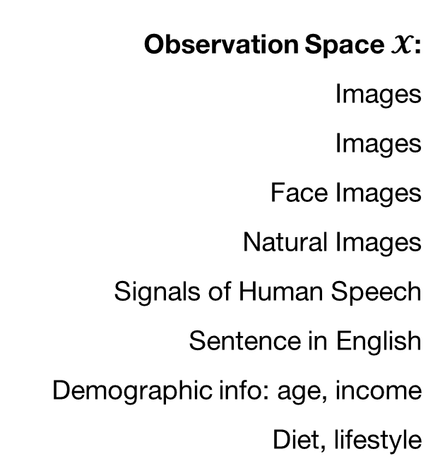
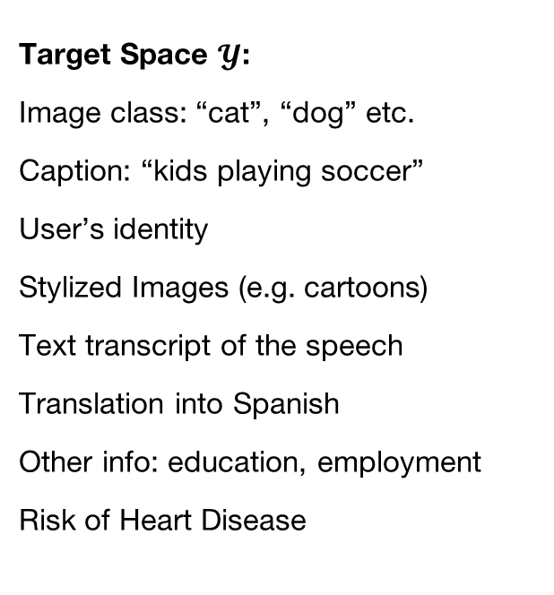
Prediction Problems
Observation Space $𝓧$:
Images
Images
Face Images
Natural Images
Signals of Human Speech
Sentence in English
Demographic info: age, income
Diet, lifestyle
Target Space $𝓨$:
Image class: “cat”, “dog” etc.
Caption: “kids playing soccer”
User’s identity
Stylized Images (e.g. cartoons)
Text transcript of the speech
Translation into Spanish
Other info: education, employment
Risk of Heart Disease

Slide 3
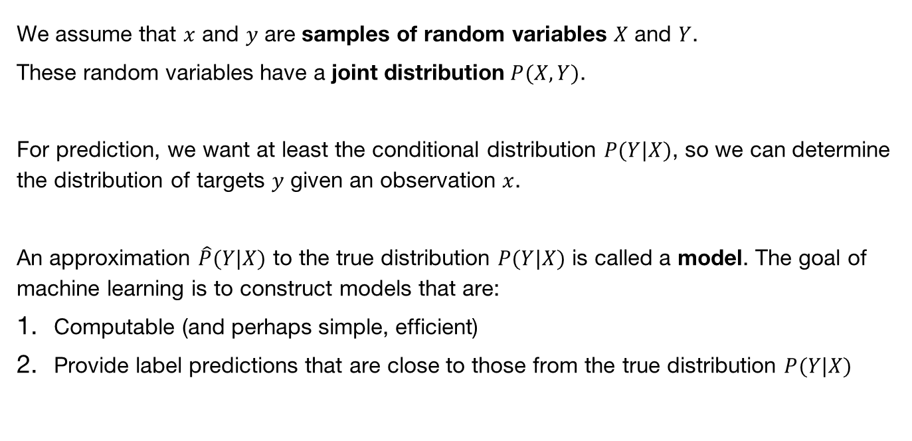
Probabilistic Framing
We assume that $x$ and $y$ are samples of random variables $X$ and $Y$.
These random variables have a joint distribution $P(X,Y)$.
For prediction, we want at least the conditional distribution $P(Y|X)$, so we can determine the distribution of targets $y$ given an observation $x$.
An approximation $\hat{P}(Y|X)$ to the true distribution $P(Y|X)$ is called a model. The goal of machine learning is to construct models that are:
Computable (and perhaps simple, efficient)
Provide label predictions that are close to those from the true distribution $P(Y|X)$

Slide 4
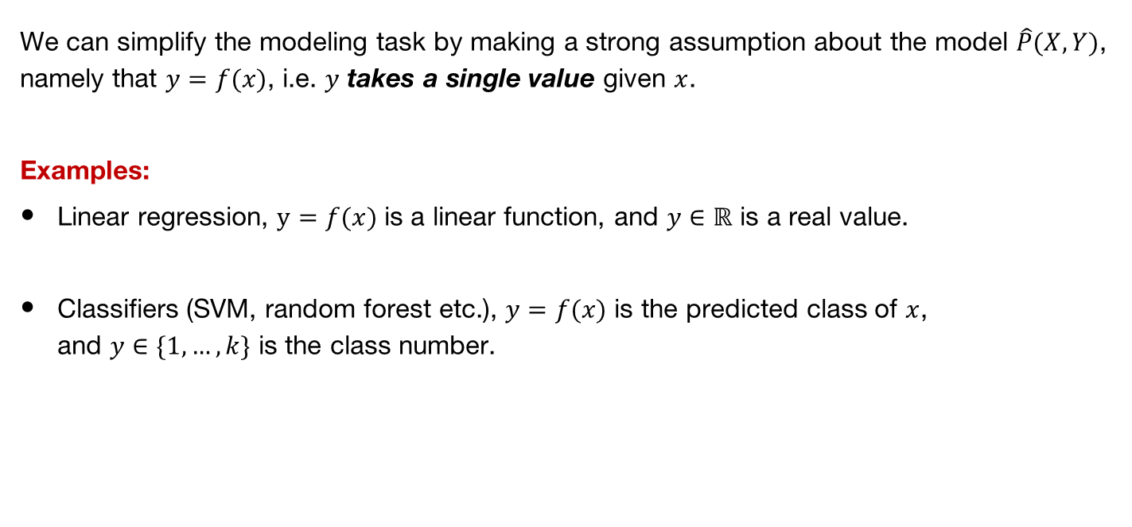
Prediction Functions
We can simplify the modeling task by making a strong assumption about the model $\hat{P}(X,Y)$, namely that $y=f(x)$, i.e. $y$ takes a single value given $x$.
Examples:
Linear regression, $y=f(x)$ is a linear function, and $y∈ℝ$ is a real value.
Classifiers (SVM, random forest etc.), $y=f(x)$ is the predicted class of $x$,
and $y∈\{1,…,k\}$ is the class number.

Slide 5
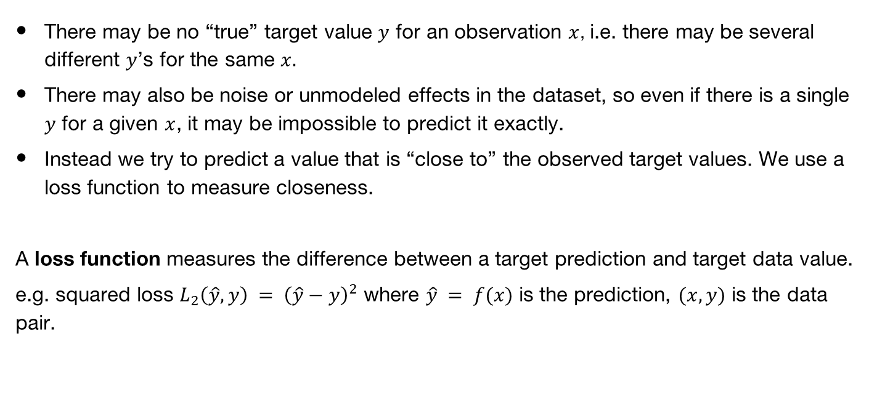
Loss Functions
There may be no “true” target value $y$ for an observation $x$, i.e. there may be several different $y$’s for the same $x.$
There may also be noise or unmodeled effects in the dataset, so even if there is a single $y$ for a given $x$, it may be impossible to predict it exactly.
Instead we try to predict a value that is “close to” the observed target values. We use a loss function to measure closeness.
A loss function measures the difference between a target prediction and target data value.
e.g. squared loss $L_{2}\left(\hat{y},y\right) = {\left(\hat{y}−y\right)}^{2}$ where $\hat{y} = f(x)$ is the prediction, $(x,y)$ is the data pair.

Slide 6
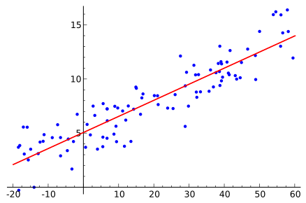


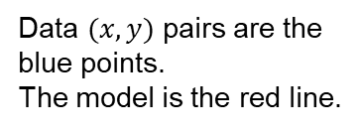



Linear Regression
Simplest case, $\hat{y}=f\left(x\right)=ax+b$ with $x$ a real value, and real constants $a$ and $b$.
The loss is the squared loss $L_{2}\left(\hat{y},y\right) = {\left(\hat{y}−y\right)}^{2}$
$$y$$
$$y$$
Data $(x,y)$ pairs are the
blue points.
The model is the red line.
$$\hat{y}$$
$$x$$

Slide 7

Linear Regression
The total loss across all points is
$$L=\sum_{i=1}^{n}{{\left({\hat{y}}_{i}−y_{i}\right)}^{2}}$$
$$= \sum_{i=1}^{n}{{\left(ax_{i}+b−y_{i}\right)}^{2}}$$
We want the optimum values of $a$ and $b$, and since the loss is differentiable, we set
$\frac{dL}{da}=0$ and $\frac{dL}{db}=0$

Slide 8
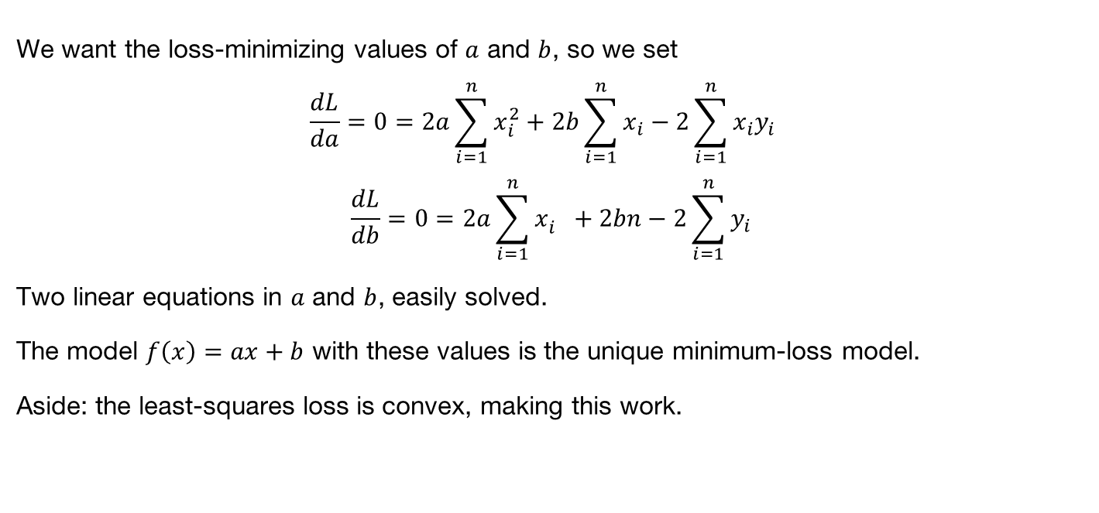
Linear Regression
We want the loss-minimizing values of $a$ and $b$, so we set
$$\frac{dL}{da}=0=2a\sum_{i=1}^{n}{x_{i}^{2}}+2b\sum_{i=1}^{n}{x_{i}}−2\sum_{i=1}^{n}{x_{i}y_{i}}$$
$$\frac{dL}{db}=0=2a\sum_{i=1}^{n}{x_{i}^{}}+2bn−2\sum_{i=1}^{n}{y_{i}}$$
Two linear equations in $a$ and $b$, easily solved.
The model $f\left(x\right)=ax+b$ with these values is the unique minimum-loss model.
Aside: the least-squares loss is convex, making this work.

Slide 9
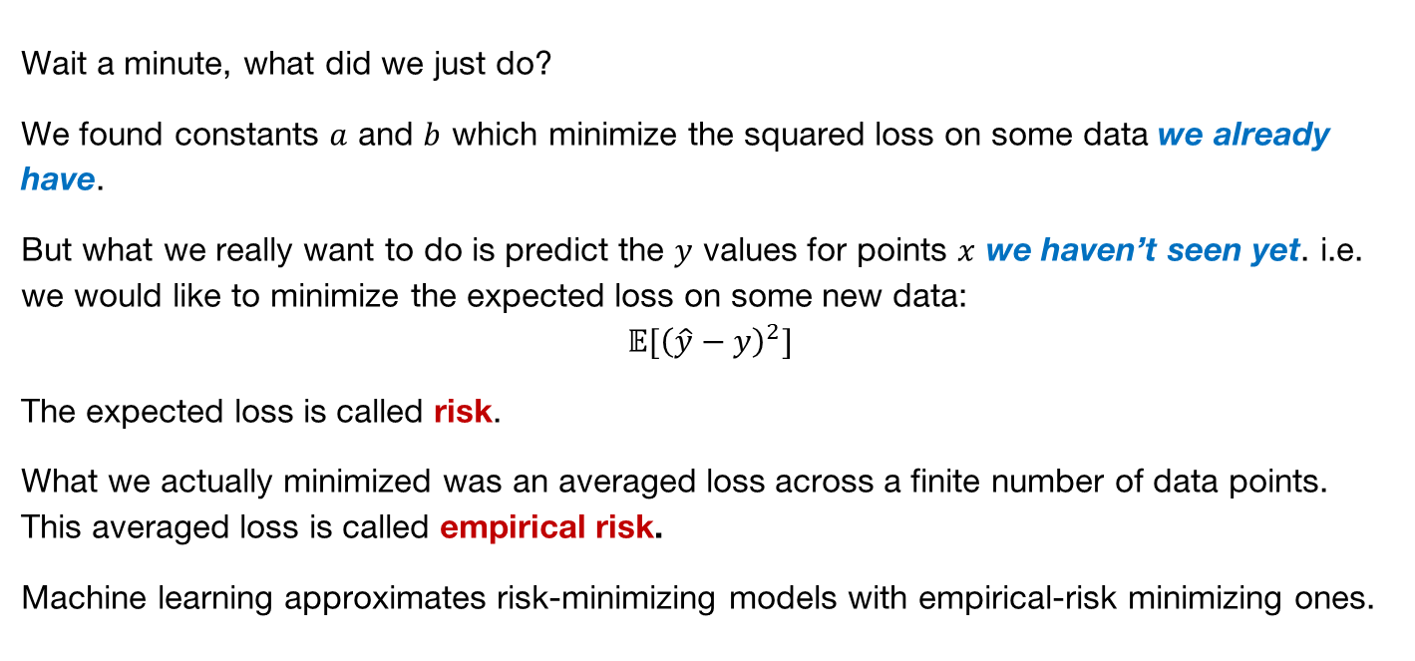
Risk Minimization
Wait a minute, what did we just do?
We found constants $a$ and $b$ which minimize the squared loss on some data we already have.
But what we really want to do is predict the $y$ values for points $x$ we haven’t seen yet. i.e. we would like to minimize the expected loss on some new data:
$$𝔼{[\left(\hat{y}−y\right)}^{2}]$$
The expected loss is called risk.
What we actually minimized was an averaged loss across a finite number of data points. This averaged loss is called empirical risk.
Machine learning approximates risk-minimizing models with empirical-risk minimizing ones.

Slide 10
Risk Minimization
Generally minimizing empirical risk (loss on the data) instead of true risk works fine, but it can fail if:
The data sample is biased. e.g. you cant build a (good) classifier with observations of only one class.
There is not enough data to accurately estimate the parameters of the model. Depends on the complexity (number of parameters, variation in gradients, complexity of the loss function, generative vs. discriminative etc.).

Slide 11
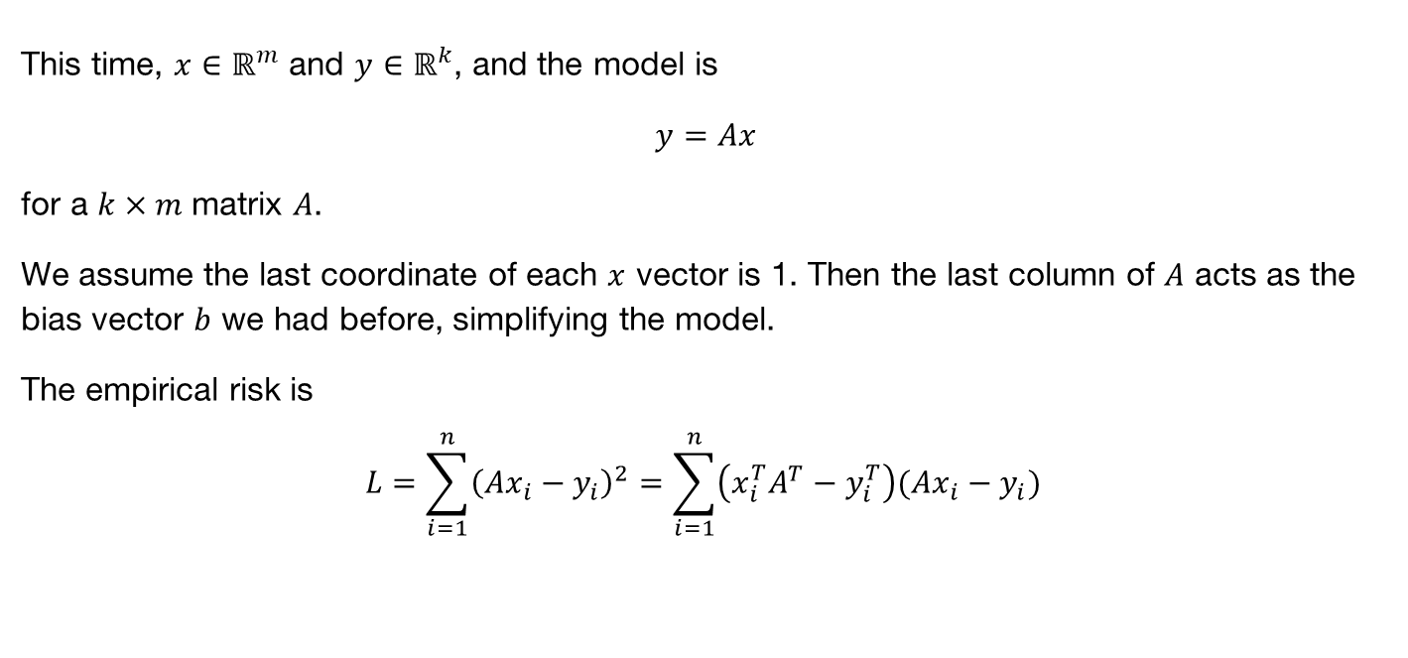
Multivariate Linear Regression
This time, $x∈ℝ^{m}$ and $y∈ℝ^{k}$, and the model is
$y=Ax$
for a $k×m$ matrix $A$.
We assume the last coordinate of each $x$ vector is 1. Then the last column of $A$ acts as the bias vector $b$ we had before, simplifying the model.
The empirical risk is
$$L=\sum_{i=1}^{n}{{\left(Ax_{i}−y_{i}\right)}^{2}}=\sum_{i=1}^{n}{\left(x_{i}^{T}A^{T}−y_{i}^{T}\right)(Ax_{i}−y_{i})}$$

Slide 12

Multivariate Linear Regression
We want to optimize $L$ with respect to the model matrix $A$, so this time we need a gradient:
$$∇_{A}L=0$$
- we are treating the loss as a function $L(A)$ of the matrix $A.$

Slide 13
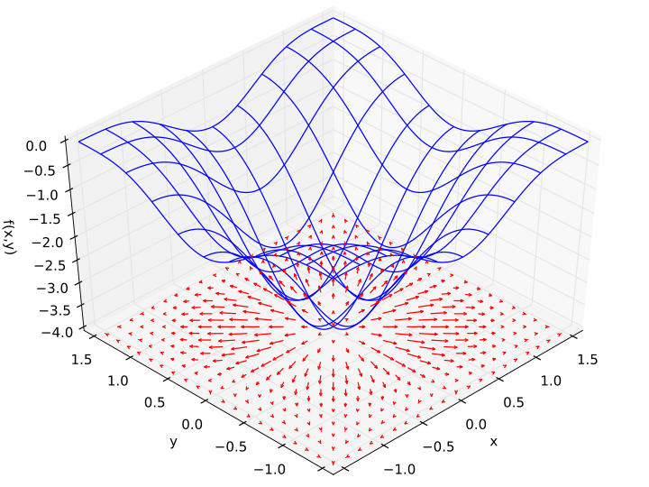
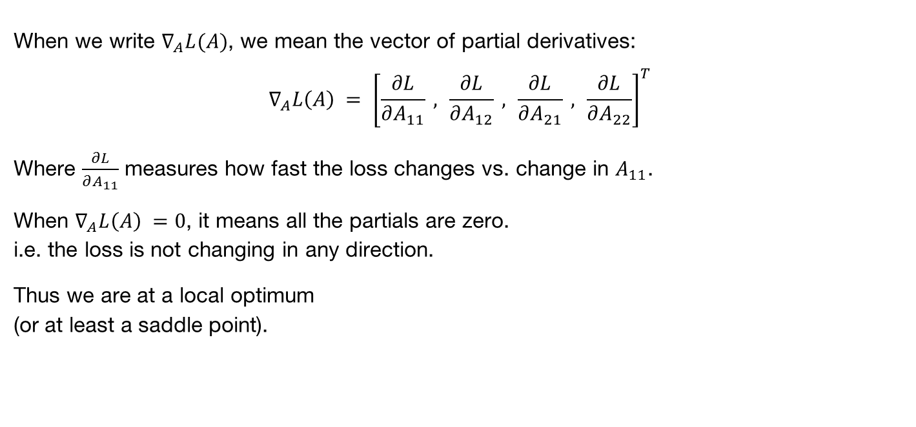
Aside: Gradients
When we write $∇_{A}L(A)$, we mean the vector of partial derivatives:
$$∇_{A}L\left(A\right) = {\left[\frac{∂L}{∂A_{11}} , \frac{∂L}{∂A_{12}} , \frac{∂L}{∂A_{21}} , \frac{∂L}{∂A_{22}}\right]}^{T}$$
Where $\frac{∂L}{∂A_{11}}$ measures how fast the loss changes vs. change in $A_{11}$.
When $∇_{A}L\left(A\right) =0$, it means all the partials are zero.
i.e. the loss is not changing in any direction.
Thus we are at a local optimum
(or at least a saddle point).
Notes:
Loss surface is blue. Gradients are shown below as red arrows. Gradient is zero at the minimum.

Slide 14
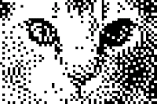
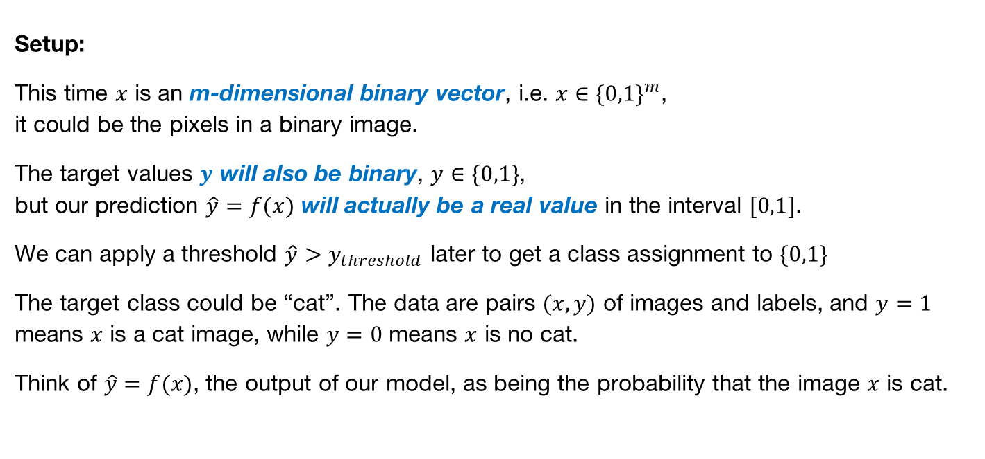
Logistic Regression
Setup:
This time $x$ is an m-dimensional binary vector, i.e. $x∈\{0,1\}^{m}$,
it could be the pixels in a binary image.
The target values $y$ will also be binary, $y∈\{0,1\}$,
but our prediction $\hat{y}=f(x)$ will actually be a real value in the interval $[0,1]$.
We can apply a threshold $\hat{y}>y_{threshold}$ later to get a class assignment to $\{0,1\}$
The target class could be “cat”. The data are pairs $(x,y)$ of images and labels, and $y=1$ means $x$ is a cat image, while $y=0$ means $x$ is no cat.
Think of $\hat{y}=f(x)$, the output of our model, as being the probability that the image $x$ is cat.

Slide 15
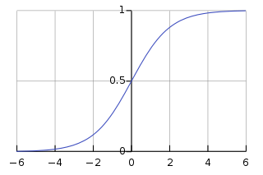



Logistic Regression
Let $w∈ℝ^{m}$ be a weight vector (the logistic model). Then
$$f\left(x\right)=\frac{1}{1+\exp\left(−w^{T}x\right)}$$
Is the probability that the output should be “cat”.
We can write this as $f\left(x\right)=g(w^{T}x)$ where $g\left(u\right)=1/\left(1+\exp\left(−u\right)\right)$ is the logistic function:
$$g\left(u\right)$$
$$u$$

Slide 16
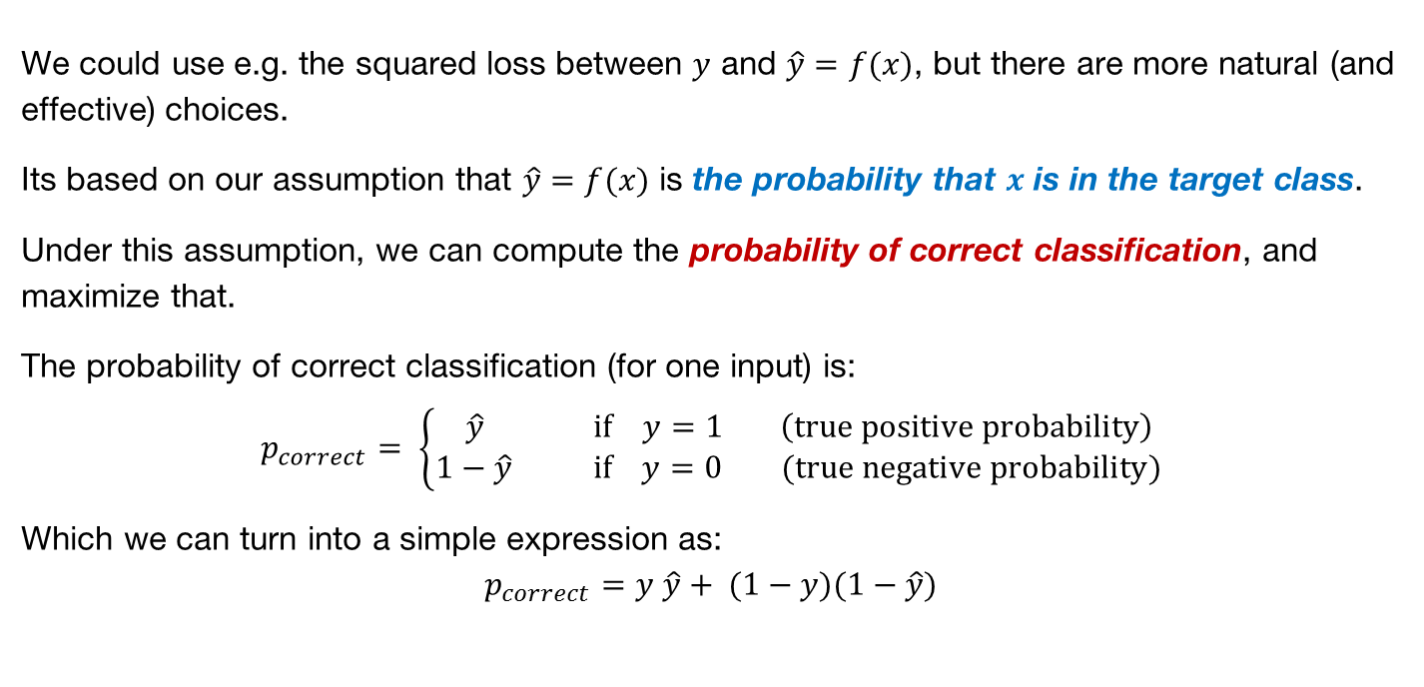
Loss for Logistic Regression
We could use e.g. the squared loss between $y$ and $\hat{y}=f(x)$, but there are more natural (and effective) choices.
Its based on our assumption that $\hat{y}=f(x)$ is the probability that $x$ is in the target class.
Under this assumption, we can compute the probability of correct classification, and maximize that.
The probability of correct classification (for one input) is:
$$p_{correct}= \left\{\begin{matrix} \hat{y} if y=1 \left(true positive probability\right) \\ 1−\hat{y} if y=0 (true negative probability)\end{matrix}\right.$$
Which we can turn into a simple expression as:
$$p_{correct}=y \hat{y}+ (1−y)(1−\hat{y})$$

Slide 17
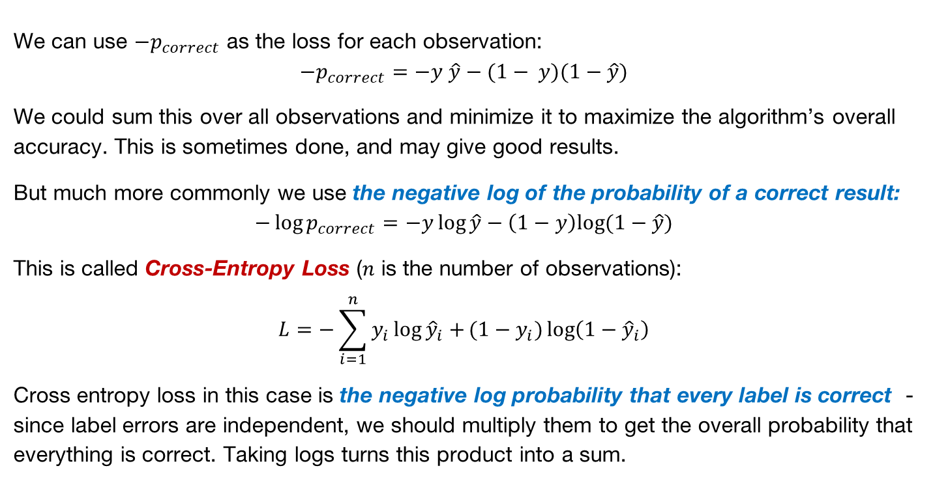
Cross-Entropy Loss
We can use $−p_{correct}$ as the loss for each observation:
$$−p_{correct}=−y \hat{y}−(1− y)(1−\hat{y})$$
We could sum this over all observations and minimize it to maximize the algorithm’s overall accuracy. This is sometimes done, and may give good results.
But much more commonly we use the negative log of the probability of a correct result:
$$−\log{p_{correct}}=−y\log{\hat{y}}−\left(1−y\right)log⁡(1−\hat{y})$$
This is called Cross-Entropy Loss ($n$ is the number of observations):
$$L=−\sum_{i=1}^{n}{y_{i}\log{{\hat{y}}_{i}}+}(1−y_{i})\log\left(1−{\hat{y}}_{i}\right)$$
Cross entropy loss in this case is the negative log probability that every label is correct - since label errors are independent, we should multiply them to get the overall probability that everything is correct. Taking logs turns this product into a sum.

Slide 18
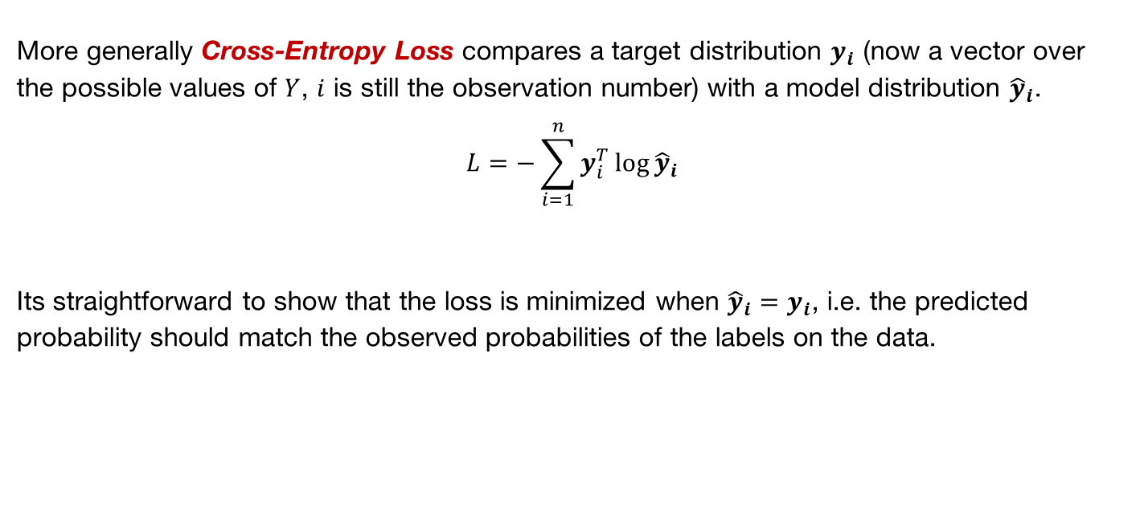
Cross-Entropy Loss
More generally Cross-Entropy Loss compares a target distribution $y_{i}$ (now a vector over the possible values of $Y$, $i$ is still the observation number) with a model distribution ${\hat{y}}_{i}$.
$$L=−\sum_{i=1}^{n}{y_{i}^{T}\log{{\hat{y}}_{i}}}$$
Its straightforward to show that the loss is minimized when ${\hat{y}}_{i}=y_{i}$, i.e. the predicted probability should match the observed probabilities of the labels on the data.

Slide 19

Logistic Regression
Is there something special about the logistic function
$$f\left(x\right)=\frac{1}{1+\exp\left(−w^{T}x\right)}$$
or would any other “sigmoid” function work?

Slide 20
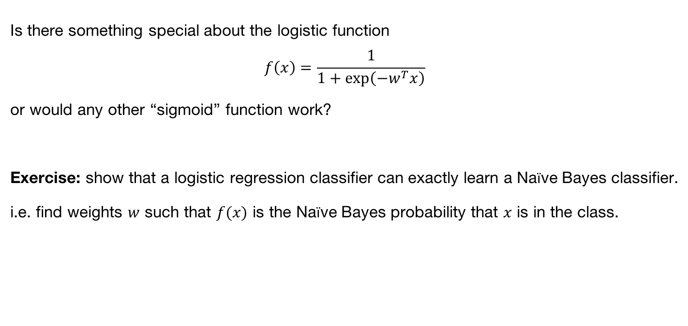
Logistic Regression
Is there something special about the logistic function
$$f\left(x\right)=\frac{1}{1+\exp\left(−w^{T}x\right)}$$
or would any other “sigmoid” function work?
Exercise: show that a logistic regression classifier can exactly learn a Naïve Bayes classifier.
i.e. find weights $w$ such that $f(x)$ is the Naïve Bayes probability that $x$ is in the class.

Slide 21
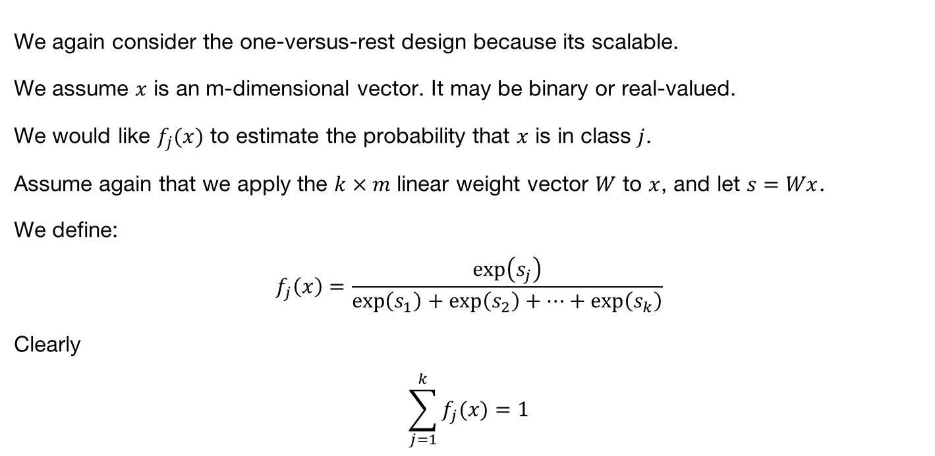
Multi-Class Logistic Regression
We again consider the one-versus-rest design because its scalable.
We assume $x$ is an m-dimensional vector. It may be binary or real-valued.
We would like $f_{j}(x)$ to estimate the probability that $x$ is in class $j$.
Assume again that we apply the $k×m$ linear weight vector $W$ to $x$, and let $s=Wx$.
We define:
$$f_{j}\left(x\right)=\frac{\exp\left(s_{j}\right)}{\exp\left(s_{1}\right)+\exp\left(s_{2}\right)+⋯+\exp\left(s_{k}\right)}$$
Clearly
$$\sum_{j=1}^{k}{f_{j}(x)}=1$$
So it acts as a probability

Slide 22
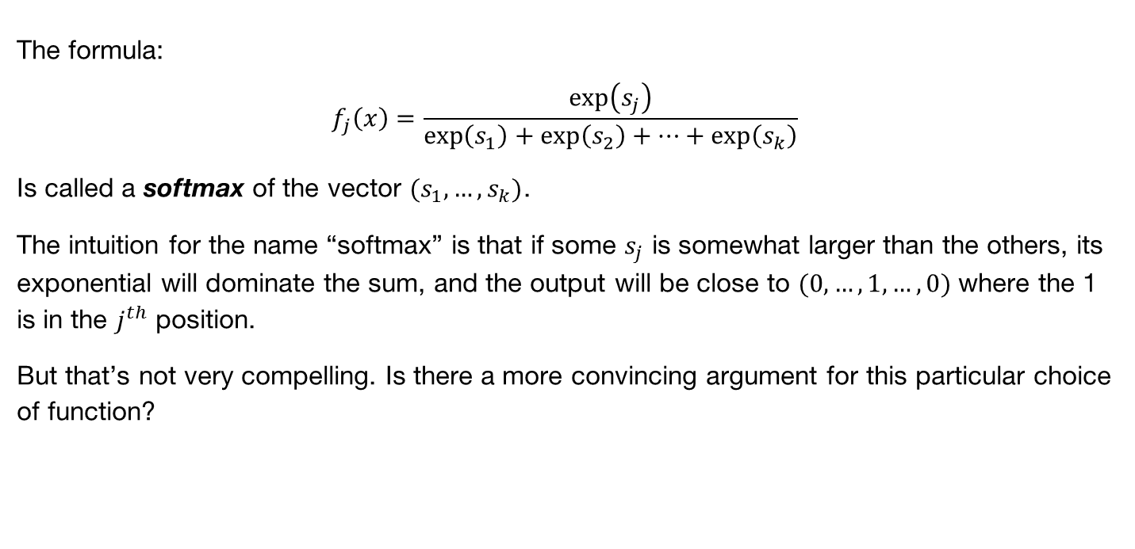
Multiclass Logistic Regression (Softmax)
The formula:
$$f_{j}\left(x\right)=\frac{\exp\left(s_{j}\right)}{\exp\left(s_{1}\right)+\exp\left(s_{2}\right)+⋯+\exp\left(s_{k}\right)}$$
Is called a softmax of the vector $(s_{1},…,s_{k})$.
The intuition for the name “softmax” is that if some $s_{j}$ is somewhat larger than the others, its exponential will dominate the sum, and the output will be close to $(0,…,1,…,0)$ where the 1 is in the $j^{th}$ position.
But that’s not very compelling. Is there a more convincing argument for this particular choice of function?

Slide 23
Optimization
General story: how do we minimize the loss?

Slide 24
Method 1: Search
Take several random steps and measure the altitude (loss). Then go to the lowest one.
Not totally crazy. This is one kind of “gradient-free” optimization. It makes sense if you can’t compute gradients for some reason (e.g. loss is not continuous or differentiable).
A slightly smarter version takes an average of the random points weighted by altitude (deeper points get higher weight). This in fact approximates the gradient.
See:
Salimans, Ho, Chen, Sidor and Sutskever “Evolution Strategies as a Scalable Alternative to Reinforcement Learning” arXiv 1703.03864, 2017.
But it’s less efficient than gradient descent when gradients are available.

Slide 25
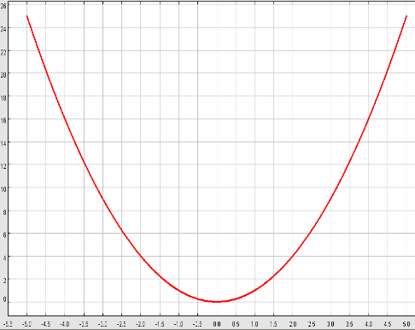
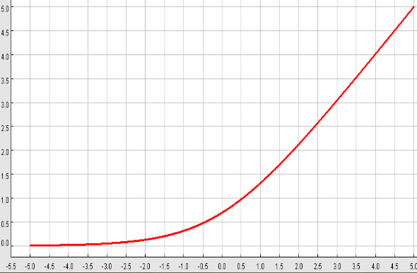



Losses we have seen so far
Squared Loss
$L={\left(y_{i}−f\left(x_{i}\right)\right)}^{2}$
Hinge Loss, $y_{i}∈\{−1,1\}$
$$L= max⁡(0,1−y_{i}f\left(x_{i}\right))$$
Cross-entropy loss on logistic function, $y_{i}∈\{−1,1\}$
$$L=\log\left(1+\exp\left(−y_{i}f(x_{i})\right)\right)$$
All three have “well behaved” derivatives. $f\left(x\right)=w^{T}x$ is a linear function
of the weights $W$, so we can differentiate loss with respect to weights.
Notes:
The hinge loss “corner” doesn’t have a well-defined derivative, but this isn’t normally a problem.

Slide 26


loss
params

Slide 27
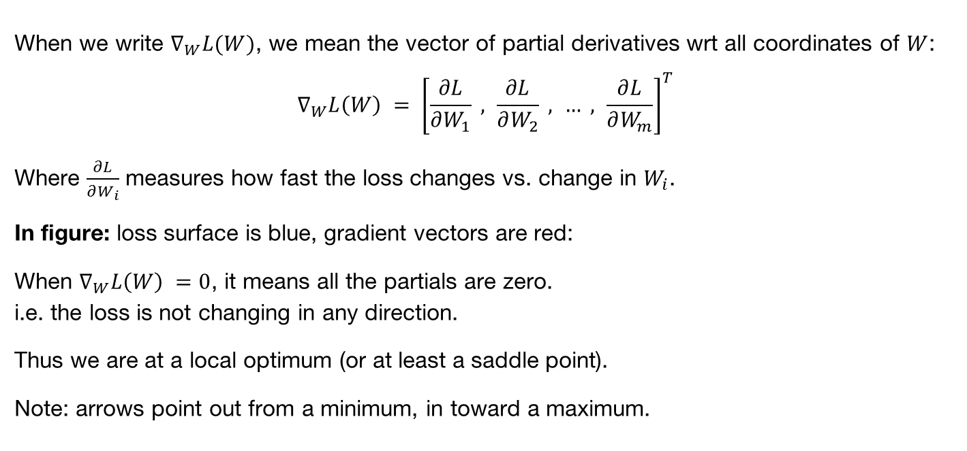
Gradients Again
When we write $∇_{W}L(W)$, we mean the vector of partial derivatives wrt all coordinates of $W$:
$$∇_{W}L\left(W\right) = {\left[\frac{∂L}{∂W_{1}} , \frac{∂L}{∂W_{2}} , … , \frac{∂L}{∂W_{m}}\right]}^{T}$$
Where $\frac{∂L}{∂W_{i}}$ measures how fast the loss changes vs. change in $W_{i}$.
In figure: loss surface is blue, gradient vectors are red:
When $∇_{W}L\left(W\right) =0$, it means all the partials are zero.
i.e. the loss is not changing in any direction.
Thus we are at a local optimum (or at least a saddle point).
Note: arrows point out from a minimum, in toward a maximum.

Slide 28
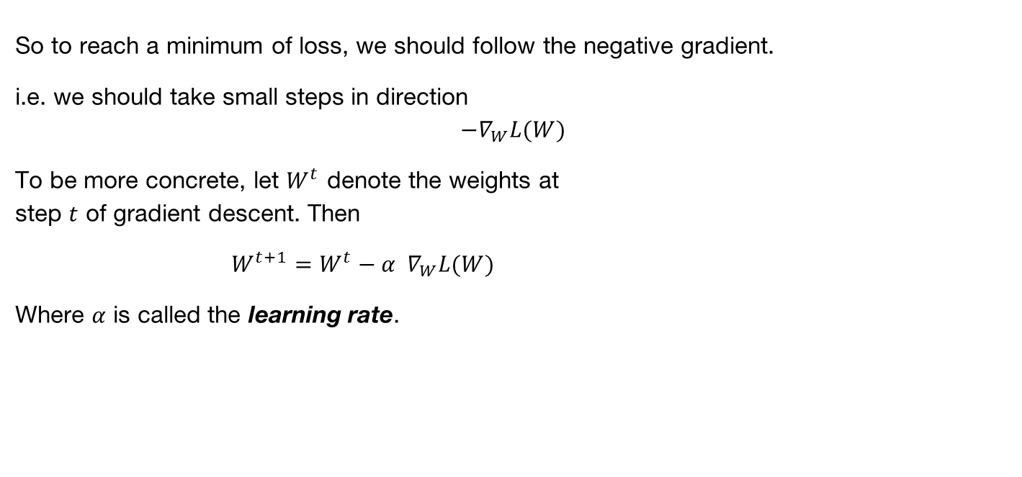
Gradient Descent
So to reach a minimum of loss, we should follow the negative gradient.
i.e. we should take small steps in direction
$$−∇_{W}L(W)$$
To be more concrete, let $W^{t}$ denote the weights at
step $t$ of gradient descent. Then
$W^{t+1}=W^{t}−α ∇_{W}L(W)$
Where $α$ is called the learning rate.

Slide 29
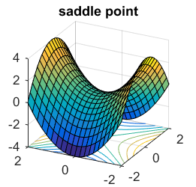
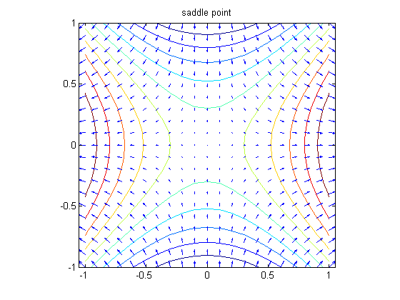
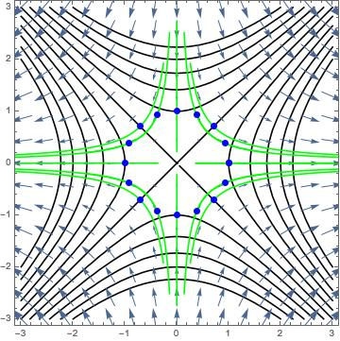
Caveat: Saddle Points
Following the negative gradient should eventually get you to a loss minimum. But it may take a long time. One reason is the presence of saddle points, where the gradient also vanishes:
Gradient vectors
Gradient flows (green)

Slide 30
Caveat: Saddle Points
Following the negative gradient should eventually get you to a loss minimum. But it may take a long time. One reason is the presence of saddle points:
Gradient vectors
Gradient flows (green)
Gradients very small in here
– slow progress

Slide 31
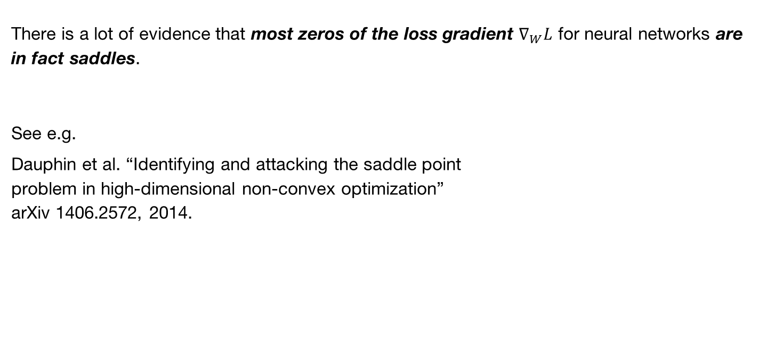
Caveat: Saddle Points
There is a lot of evidence that most zeros of the loss gradient $∇_{W}L$ for neural networks are in fact saddles.
See e.g.
Dauphin et al. “Identifying and attacking the saddle point
problem in high-dimensional non-convex optimization”
arXiv 1406.2572, 2014.

Slide 32
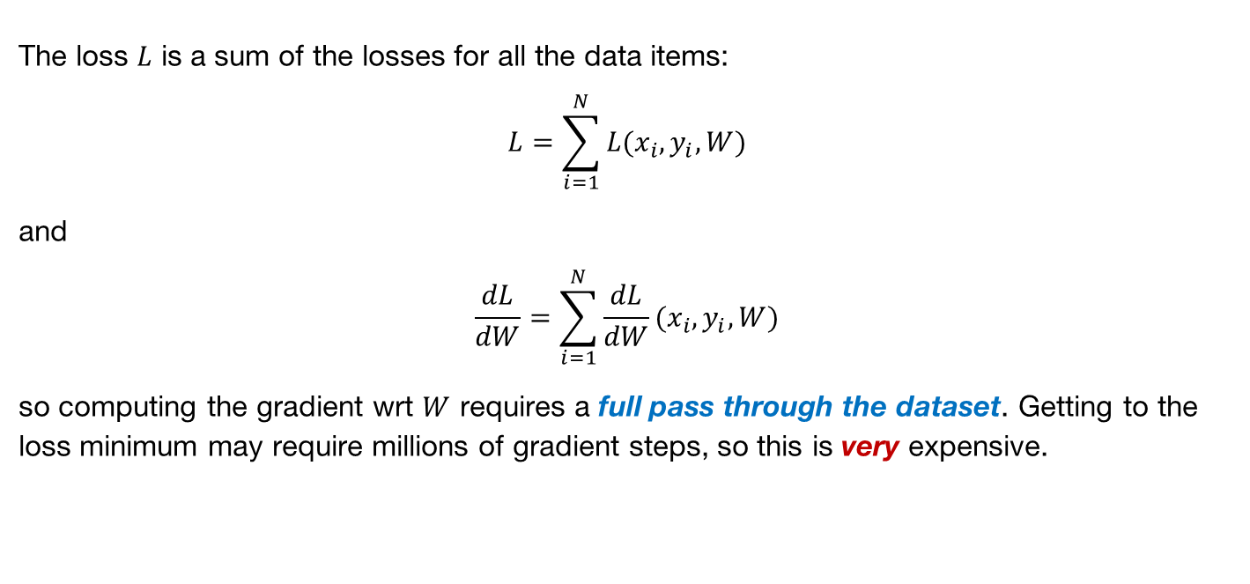
Caveat: Efficiency
The loss $L$ is a sum of the losses for all the data items:
$$L=\sum_{i=1}^{N}{L(x_{i},y_{i},W)}$$
and
$$\frac{dL}{dW}=\sum_{i=1}^{N}{\frac{dL}{dW}(x_{i},y_{i},W)}$$
so computing the gradient wrt $W$ requires a full pass through the dataset. Getting to the loss minimum may require millions of gradient steps, so this is very expensive.

Slide 33
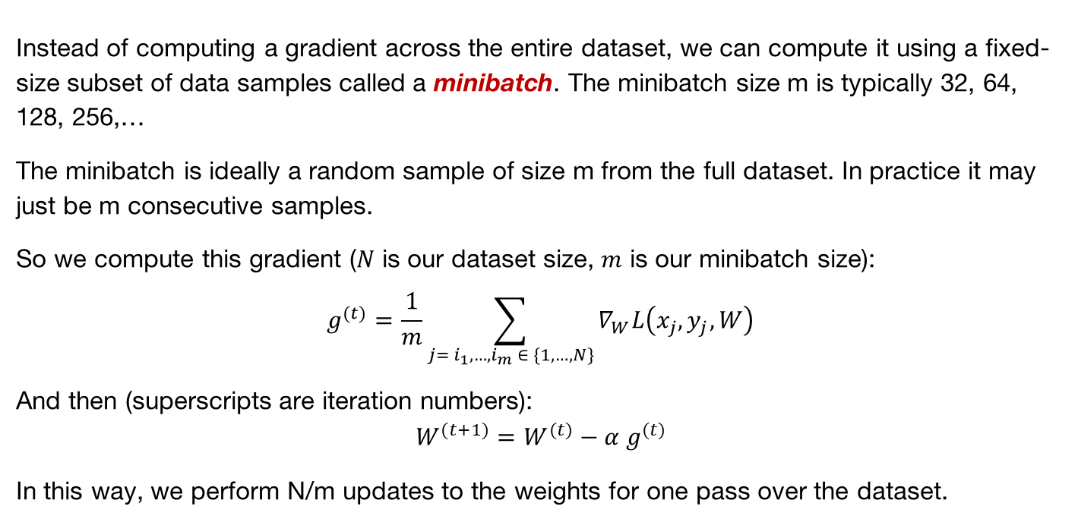
Minibatches
Instead of computing a gradient across the entire dataset, we can compute it using a fixed-size subset of data samples called a minibatch. The minibatch size m is typically 32, 64, 128, 256,…
The minibatch is ideally a random sample of size m from the full dataset. In practice it may just be m consecutive samples.
So we compute this gradient ($N$ is our dataset size, $m$ is our minibatch size):
$$g^{(t)}=\frac{1}{m}\sum_{j= i_{1},…,i_{m} ∈ \{1,…,N\}}{∇_{W}L\left(x_{j},y_{j},W\right)}$$
And then (superscripts are iteration numbers):
$$W^{(t+1)}=W^{(t)}−α g^{(t)}$$
In this way, we perform N/m updates to the weights for one pass over the dataset.

Slide 34
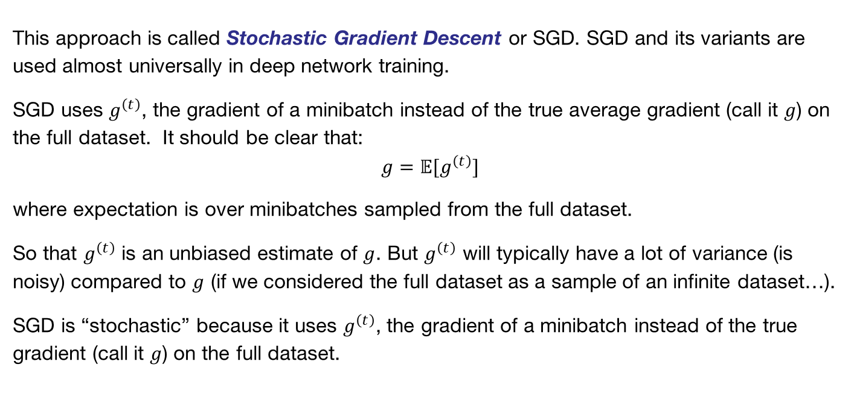
Stochastic Gradient Descent
This approach is called Stochastic Gradient Descent or SGD. SGD and its variants are used almost universally in deep network training.
SGD uses $g^{\left(t\right)}$, the gradient of a minibatch instead of the true average gradient (call it $g$) on the full dataset. It should be clear that:
$$g=𝔼[g^{\left(t\right)}]$$
where expectation is over minibatches sampled from the full dataset.
So that $g^{\left(t\right)}$ is an unbiased estimate of $g$. But $g^{\left(t\right)}$ will typically have a lot of variance (is noisy) compared to $g$ (if we considered the full dataset as a sample of an infinite dataset…).
SGD is “stochastic” because it uses $g^{\left(t\right)}$, the gradient of a minibatch instead of the true gradient (call it $g$) on the full dataset.

Slide 35
Other optimization algorithms
Simple Gradient Methods like SGD can make adequate progress to an optimum when used on minibatches of data.
Second-order methods (quasi-Newton) make much better progress toward a gradient zero, but are more expensive and unstable. They also can’t distinguish optima from saddle points, and get trapped in the latter.
Momentum: is another method to produce better effective gradients.
ADAGRAD, RMSprop: diagonally scale the gradient. ADAM diagonally scales and applies momentum.
Nesterov Momentum: can improve over vanilla SGD by gradient “look-ahead”

Slide 36
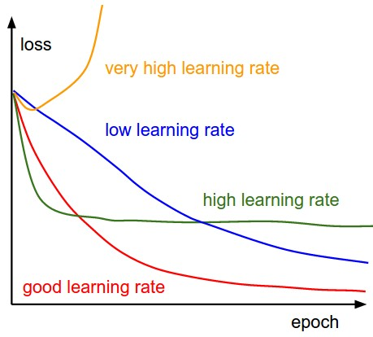



SGD, SGD+Momentum, Adagrad, RMSProp, Adam all have learning rate as a hyperparameter.
=> Learning rate decay over time!
step decay: e.g. decay learning rate by half every few epochs.
exponential decay:
1/t decay:
$1/\sqrt{t}$ decay (ADAGRAD): $α=α_{0}/\sqrt{1+kt}$

Slide 37
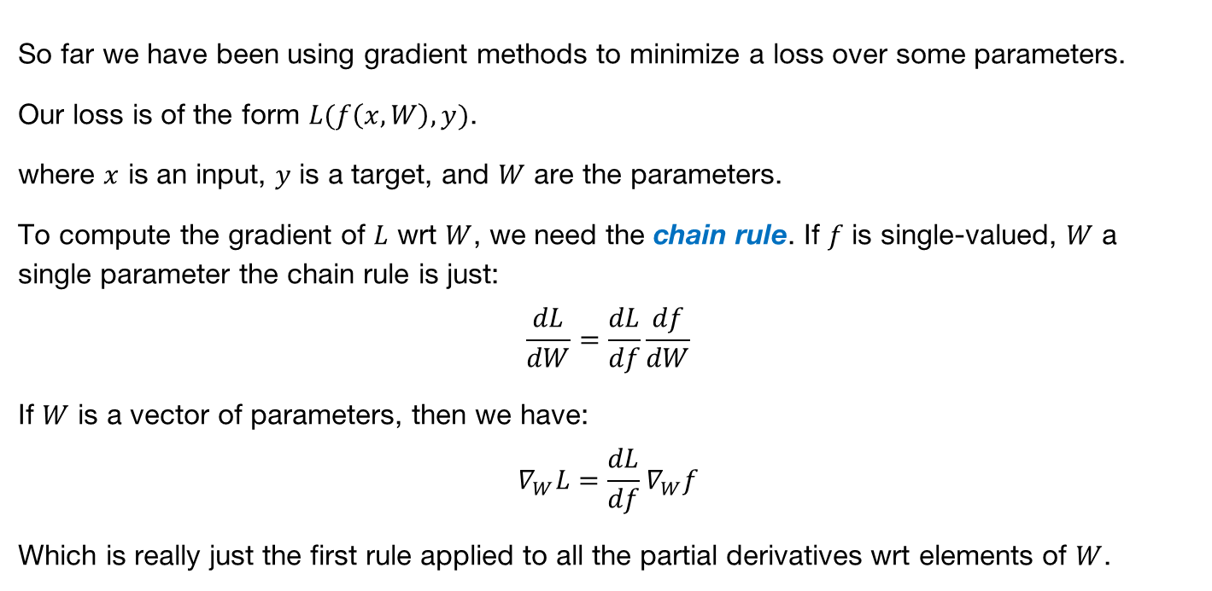
Next Topic: Backpropagation
So far we have been using gradient methods to minimize a loss over some parameters.
Our loss is of the form $L(f\left(x,W\right),y)$.
where $x$ is an input, $y$ is a target, and $W$ are the parameters.
To compute the gradient of $L$ wrt $W$, we need the chain rule. If $f$ is single-valued, $W$ a single parameter the chain rule is just:
$$\frac{dL}{dW}=\frac{dL}{df}\frac{df}{dW}$$
If $W$ is a vector of parameters, then we have:
$$∇_{W}L=\frac{dL}{df}∇_{W}f$$
Which is really just the first rule applied to all the partial derivatives wrt elements of $W$.

Slide 38
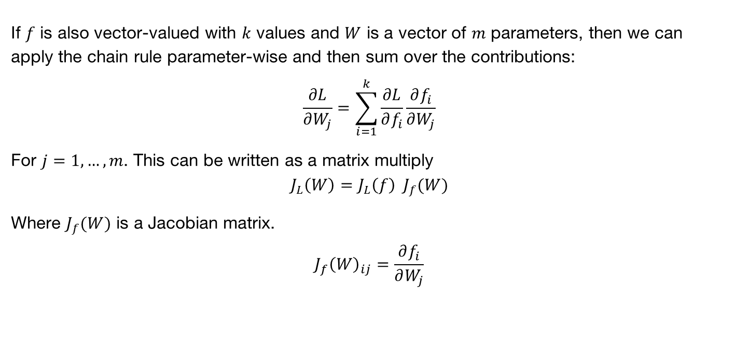
The Chain Rule
If $f$ is also vector-valued with $k$ values and $W$ is a vector of $m$ parameters, then we can apply the chain rule parameter-wise and then sum over the contributions:
$$\frac{∂L}{∂W_{j}}=\sum_{i=1}^{k}{\frac{∂L}{∂f_{i}}\frac{∂f_{i}}{∂W_{j}}}$$
For $j=1,…,m$. This can be written as a matrix multiply
$$J_{L}\left(W\right)=J_{L}\left(f\right) J_{f}(W)$$
Where $J_{f}(W)$ is a Jacobian matrix.
$$J_{f}{\left(W\right)}_{ij}=\frac{∂f_{i}}{∂W_{j}}$$

Slide 39
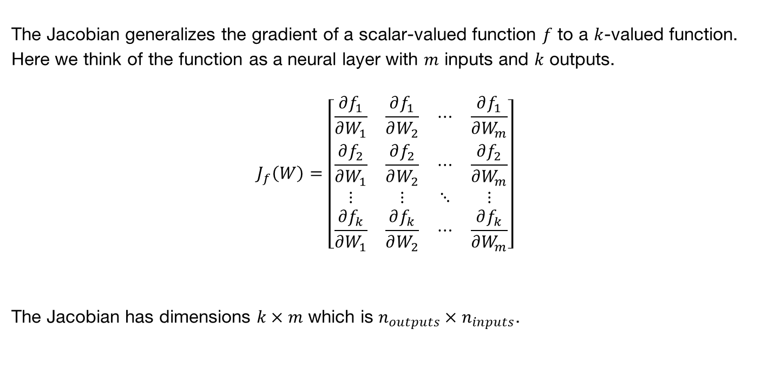
Jacobians
The Jacobian generalizes the gradient of a scalar-valued function $f$ to a $k$-valued function. Here we think of the function as a neural layer with $m$ inputs and $k$ outputs.
$$J_{f}\left(W\right)=\left[\begin{matrix}\frac{∂f_{1}}{∂W_{1}} & \frac{∂f_{1}}{∂W_{2}} & ⋯ & \frac{∂f_{1}}{∂W_{m}} \\ \frac{∂f_{2}}{∂W_{1}} & \frac{∂f_{2}}{∂W_{2}} & ⋯ & \frac{∂f_{2}}{∂W_{m}} \\ ⋮ & ⋮ & ⋱ & ⋮ \\ \frac{∂f_{k}}{∂W_{1}} & \frac{∂f_{k}}{∂W_{2}} & ⋯ & \frac{∂f_{k}}{∂W_{m}}\end{matrix}\right]$$
The Jacobian has dimensions $k×m$ which is $n_{outputs}×n_{inputs}$.

Slide 40
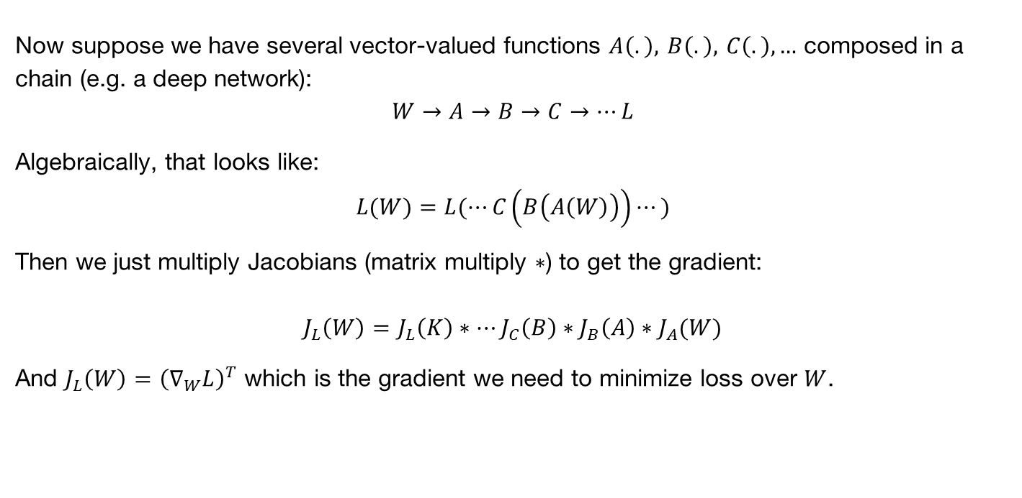
N-step Chain Rule
Now suppose we have several vector-valued functions $A\left(.\right), B\left(.\right), C\left(.\right),…$ composed in a chain (e.g. a deep network):
$$W→A→B→C→⋯L$$
Algebraically, that looks like:
$$L(W)=L(⋯C\left(B\left(A\left(W\right)\right)\right)⋯)$$
Then we just multiply Jacobians (matrix multiply $∗$) to get the gradient:
$$J_{L}\left(W\right)=J_{L}\left(K\right)∗⋯J_{C}\left(B\right)∗J_{B}\left(A\right)∗J_{A}(W)$$
And $J_{L}\left(W\right)={\left(∇_{W}L\right)}^{T}$ which is the gradient we need to minimize loss over $W$.

Slide 41
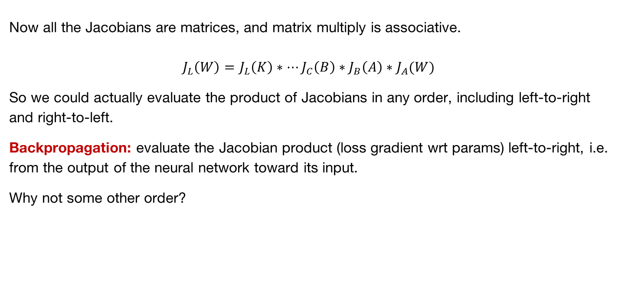
Backpropagation
Now all the Jacobians are matrices, and matrix multiply is associative.
$$J_{L}\left(W\right)=J_{L}\left(K\right)∗⋯J_{C}\left(B\right)∗J_{B}\left(A\right)∗J_{A}(W)$$
So we could actually evaluate the product of Jacobians in any order, including left-to-right and right-to-left.
Backpropagation: evaluate the Jacobian product (loss gradient wrt params) left-to-right, i.e. from the output of the neural network toward its input.
Why not some other order?

Slide 42

Backpropagation
Reason 1: Efficiency
Output Jacobian is always a row vector (because loss is a scalar). Matrix-vector multiply is much less expensive than matrix-matrix multiply.
$$J_{D}\left(W\right)=J_{D}\left(C\right) ∗ J_{C}\left(B\right) ∗ J_{B}\left(A\right) ∗ J_{A}(W)$$
Do first (output layer)
Jacobians (matrix shape)
Back (output) of network
Front (input) of network

Slide 43

Backpropagation
Reason 1: Efficiency
Output Jacobian is always a row vector. Matrix-vector multiply is much less expensive than matrix-matrix multiply.
$$J_{D}\left(W\right)=J_{D}\left(C\right) ∗ J_{C}\left(B\right) ∗ J_{B}\left(A\right) ∗ J_{A}(W)$$
Do next
Product of
matrices to
my left
Back (output) of network
Front (input) of network

Slide 44
Backpropagation
Reason 1: Efficiency
Output Jacobian is always a row vector. Matrix-vector multiply is much less expensive than matrix-matrix multiply.
$$J_{D}\left(W\right)=J_{D}\left(C\right) ∗ J_{C}\left(B\right) ∗ J_{B}\left(A\right) ∗ J_{A}(W)$$
Do next
Product of
matrices to
my left
Back (output) of network
Front (input) of network

Slide 45
Backpropagation
Reason 1: Efficiency
Output Jacobian is always a row vector. Matrix-vector multiply is much less expensive than matrix-matrix multiply.
$$J_{D}\left(W\right)=J_{D}\left(C\right) ∗ J_{C}\left(B\right) ∗ J_{B}\left(A\right) ∗ J_{A}(W)$$
Final result, without any matrix-matrix multiplies
Product of
all matrices
Back (output) of network
Front (input) of network

Slide 46

For-propagation
Reason 1: Efficiency
By comparison, we could invent “for-propagation”:
$$J_{D}\left(W\right)=J_{D}\left(C\right) ∗ J_{C}\left(B\right) ∗ J_{B}\left(A\right) ∗ J_{A}(W)$$
Do first
Back (output) of network
Front (input) of network

Slide 47

For-propagation
Reason 1: Efficiency
We could invent “for-propagation”: Oops, cost $O(n^{3})$ instead of $O\left(n^{2}\right)$ for the first multiply and we still have another matrix-matrix multiply to do.
A good invention for the wastebasket…
$$J_{D}\left(W\right)=J_{D}\left(C\right) ∗ J_{C}\left(B\right) ∗ J_{B}\left(A\right) ∗ J_{A}(W)$$
Do first
Product of
matrices to
my right
Back (output) of network
Front (input) of network

Slide 48









Backpropagation
Reason 2 to use backpropagation: Common subexpressions.
Let’s build a real neural network (Tensorflow style):
$$W_{1}$$
$$W_{2}$$
$$x$$
$$h_{1}$$
$$h_{2}$$
$$\hat{y}$$
Matrix
multiply
$$W_{1}x$$
ReLU
Matrix
multiply
$$W_{2}h_{2}$$
$$L(x,y,W_{1},W_{2})$$
loss
$$y$$
Notes:
x and y are input and target respectively.
W_1 and W_2 are learnable weight matrices.
Input, output and hidden layers are column vectors.

Slide 49

Backpropagation
Reason 2 to use backpropagation: Common subexpressions.
Let’s build a real neural network (Tensorflow style):
$$W_{1}$$
$$W_{2}$$
$$x$$
$$h_{1}$$
$$h_{2}$$
$$J_{L}{\left(\hat{y}\right)}^{}$$
$$\hat{y}$$
Matrix
multiply
$$W_{1}x$$
ReLU
Matrix
multiply
$$W_{2}h_{2}$$
$$L(x,y,W_{1},W_{2})$$
loss
1
$$y$$
Note: the Jacobians are actually row
vectors, transposes left out for readability.
Notes:
x and y are input and target respectively.
W_1 and W_2 are learnable weight matrices.
Input, output and hidden layers are column vectors.

Slide 50



Backpropagation
Reason 2 to use backpropagation: Common subexpressions.
Let’s build a real neural network (Tensorflow style):
$$W_{1}$$
$$W_{2}$$
$$J_{L}\left(W_{2}\right)=J_{L}\left(\hat{y}\right) ∗ J_{\hat{y}}\left(W_{2}\right)$$
$$x$$
$$h_{1}$$
$$h_{2}$$
Common
subexpression
$$\hat{y}$$
$$J_{L}(\hat{y})$$
Matrix
multiply
$$W_{1}x$$
ReLU
Matrix
multiply
$$W_{2}h_{2}$$
$$L(x,y,W_{1},W_{2})$$
loss
1
$$y$$
$$J_{L}\left(h_{2}\right)=J_{L}\left(\hat{y}\right) ∗ J_{\hat{y}}\left(h_{2}\right)$$
Notes:
x and y are input and target respectively.
W_1 and W_2 are learnable weight matrices.
Input, output and hidden layers are column vectors.

Slide 51








Backpropagation
Reason 2 to use backpropagation: Common subexpressions.
Let’s build a real neural network (Tensorflow style):
$$W_{1}$$
$$W_{2}$$
$$J_{L}\left(W_{1}\right)=J_{L}\left(h_{1}\right)∗J_{h_{1}}\left(W_{1}\right)$$
$$x$$
$$h_{1}$$
$$h_{2}$$
$$\hat{y}$$
Matrix
multiply
$$W_{1}x$$
ReLU
Matrix
multiply
$$W_{2}h_{2}$$
$$L(x,y,W_{1},W_{2})$$
loss
1
$$y$$
$$J_{L}\left(h_{1}\right)=J_{L}\left(h_{2}\right) ∗ J_{h_{2}}\left(h_{1}\right)$$
Notes:
The Jacobian for a weight layer is the product of matrices on the path from the weight layer to the output.
Backprop shares the products along common paths to the output layer.

Slide 52
Backpropagation
Compute function values (activations) from the first layer to the last.
Compute derivatives of the loss wrt other layers from the last layer to the first (backpropagation).
This only requires matrix-vector multiplies.
Paths from the loss layer to inner layers are re-used.

